Slide 1
Crash Reporting
Data Analytics w/ Python
Group 5
Maheshwari Bhandare
Shwetalee Gadekar
Divya Parekh
Ankita Dhekane

Slide 2
This dataset captures detailed road crash information, including crash date, location, road conditions, vehicle details, driver behavior, and environmental factors. It's designed to help analyze crash causes and outcomes. Key Columns
Crash Date/Time - Date and Time of crash.
Collision Type - Type of collision.
Driver At Fault - Whether this driver was at fault.
Injury Severity - Severity of injury to this driver.
Vehicle Movement - The movement of the vehicle at the time of the collision.
Traffic Control - Signage or traffic control devices.
Weather - Weather at collision location.
Surface Condition - Condition of roadway surface.
Light - Lighting conditions.
Driver Substance Abuse - Substance abuse detected for all drivers involved.
Driver Distracted By - The reason the driver was distracted.
Latitude - Y coordinate of crash location.
Longitude - X coordinate of crash location.

Slide 3
Data Preparation & Cleaning

Slide 4
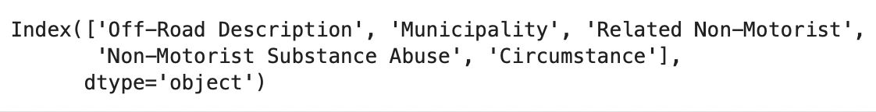
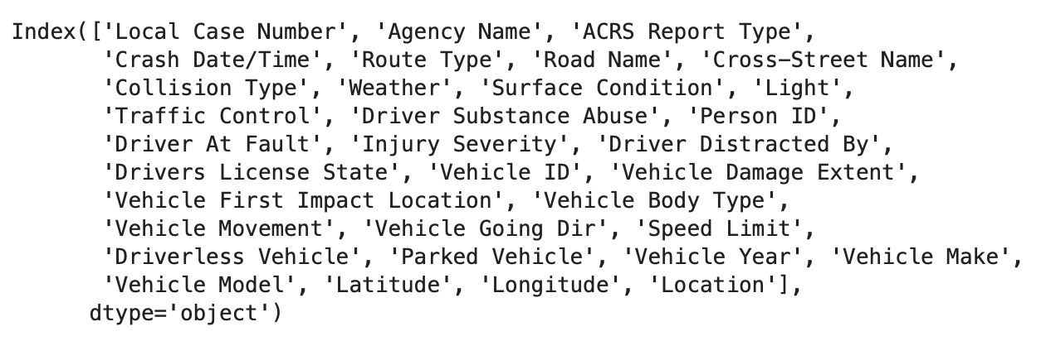
1. Dropped columns with more than 80% of NaN value on average
Data Preparation and Cleaning
Considered Columns

Slide 5
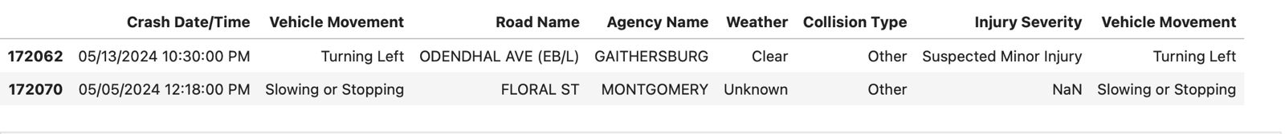
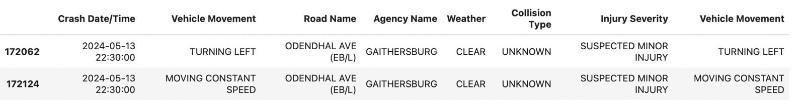
2. Replaced missing and 'OTHER' values with 'UNKNOWN' for uniformity
Data Preparation and Cleaning
Before
After

Slide 6
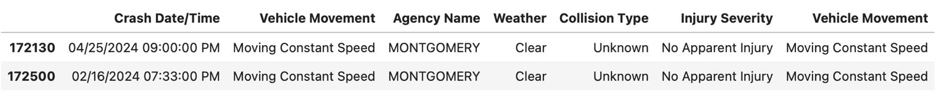
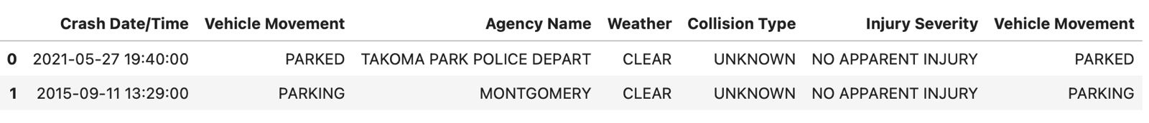
3. Standardize text data - Converted all string columns to uppercase for consistency
Data Preparation and Cleaning
Before
After

Slide 7
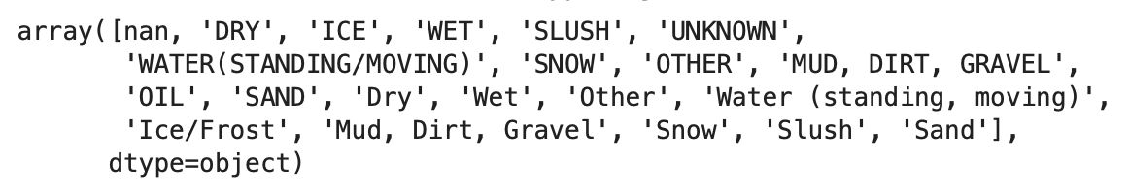
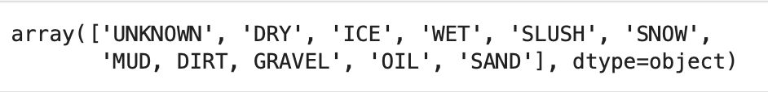
4. Column-wise cleaning for unique values (5 columns)
Data Preparation and Cleaning
Before
After

Slide 8
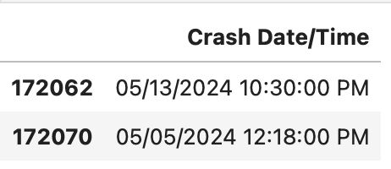
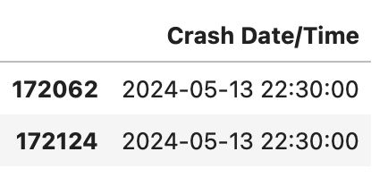
5. Crash Date/Time column converted to 24-hour format
Data Preparation and Cleaning
Before
After

Slide 9
Data Exploration

Slide 10
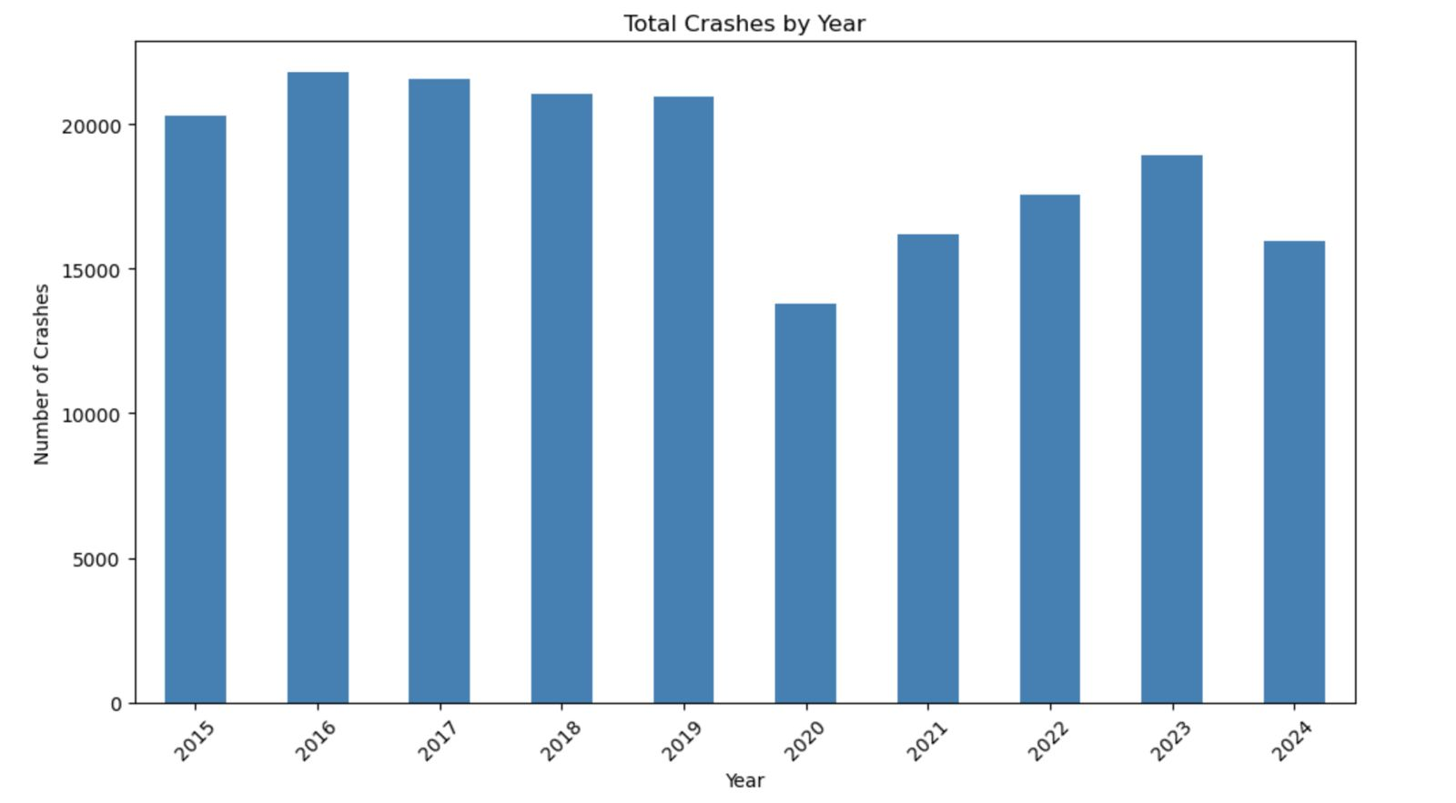
Data Exploration
The chart shows how events like the pandemic can have a significant impact on road activity, with crashes decreasing during lockdowns, followed by the heavy adoption of WFH, and gradually increasing as normal life resumes.

Slide 11
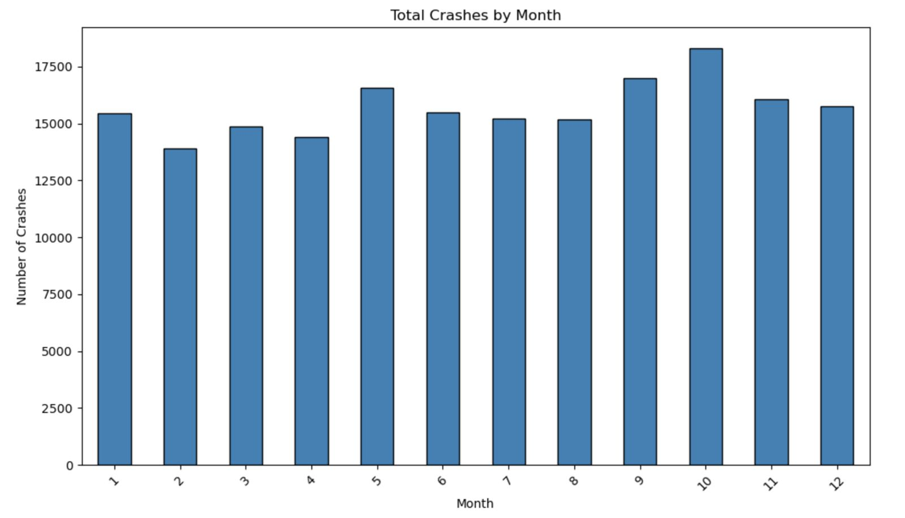
Data Exploration
Crashes are relatively consistent across the year. Slightly higher crashes occur in September and October due to seasonal changes, back-to-school traffic, festivals and celebrations like Halloween.

Slide 12
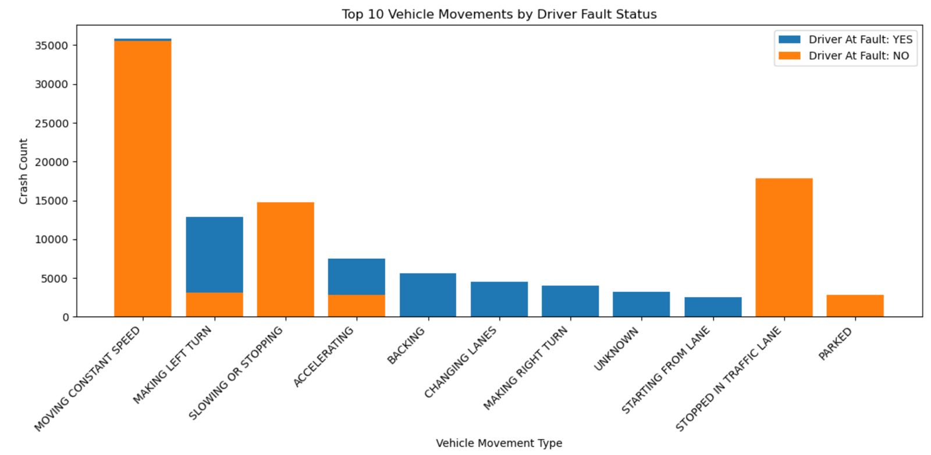
Data Exploration
This chart helps identify high-risk vehicle movements and their correlation with driver fault, providing valuable insights for road safety strategies.

Slide 13
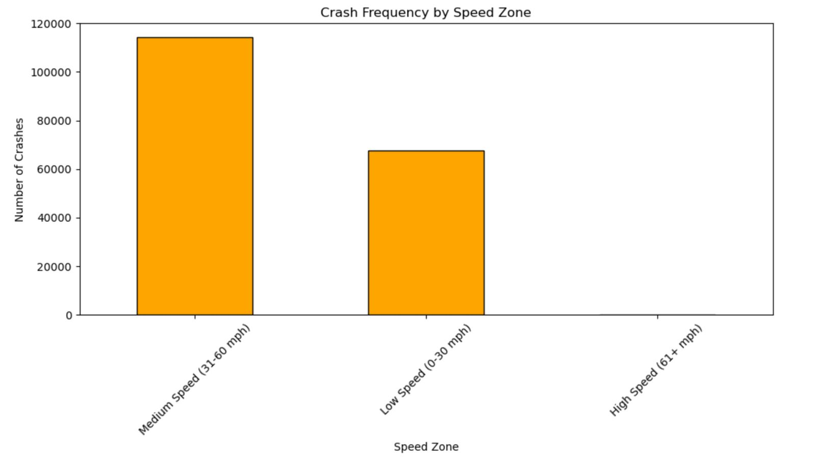
Data Exploration
This analysis highlights the relationship between speed zones and crash frequency, emphasizing the need for targeted safety measures in medium and low-speed zones.

Slide 14
Findings

Slide 15
Finding #1: Weather Impact on Crash Incidents
Crashes peaked under conditions often deemed safest—clear weather, dry surfaces, and daylight—highlighting that optimal environments alone cannot prevent accidents.
Clustering applied to identify accident patterns under varied environmental conditions

Slide 16
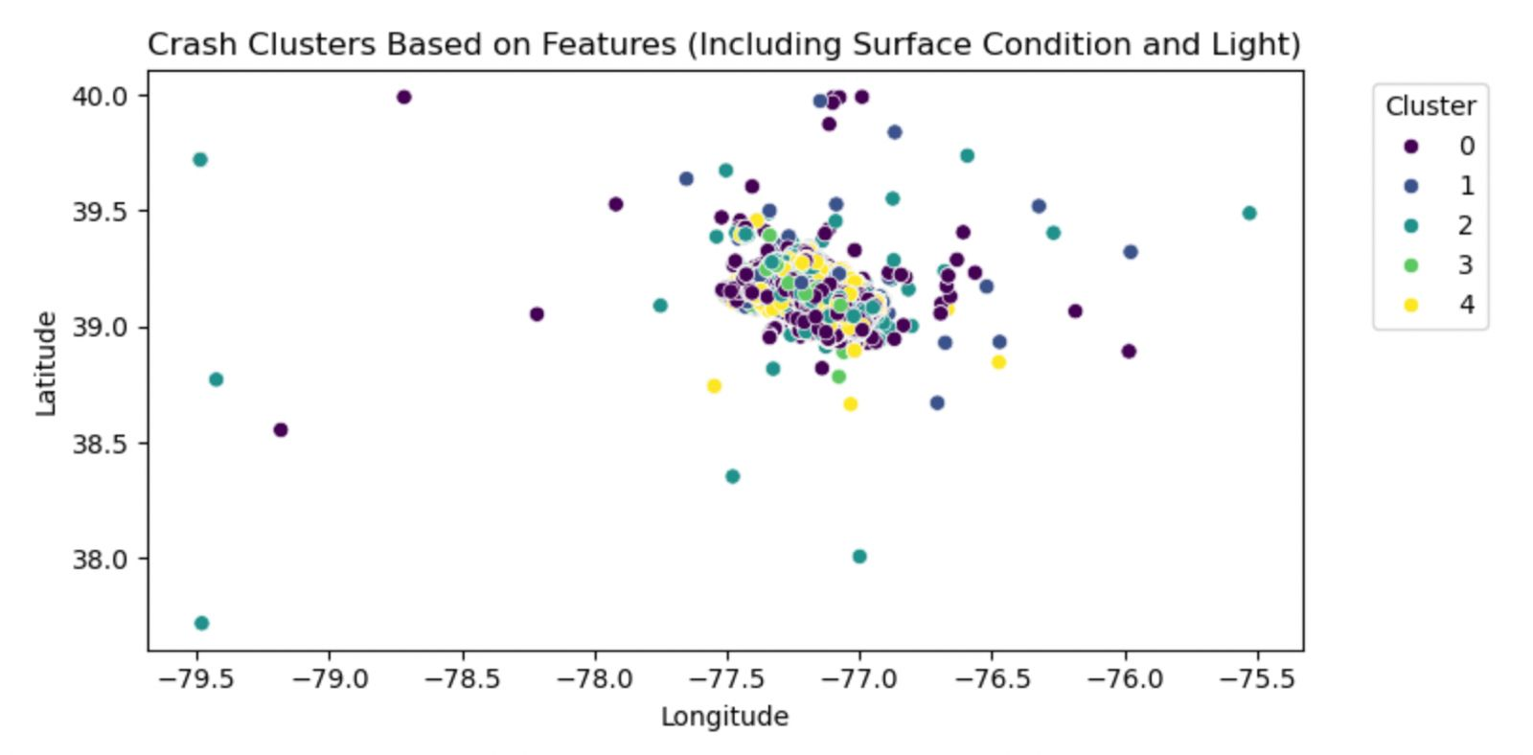

Slide 17
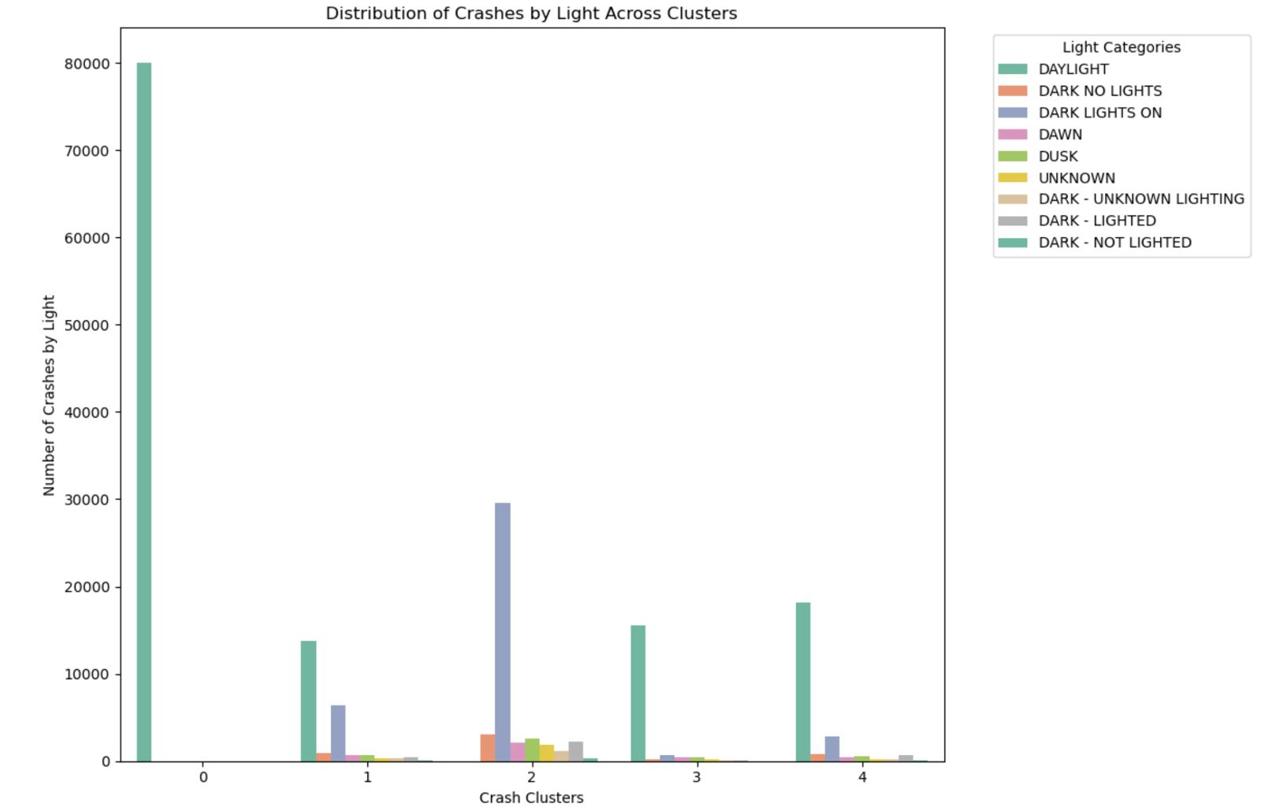

Slide 18
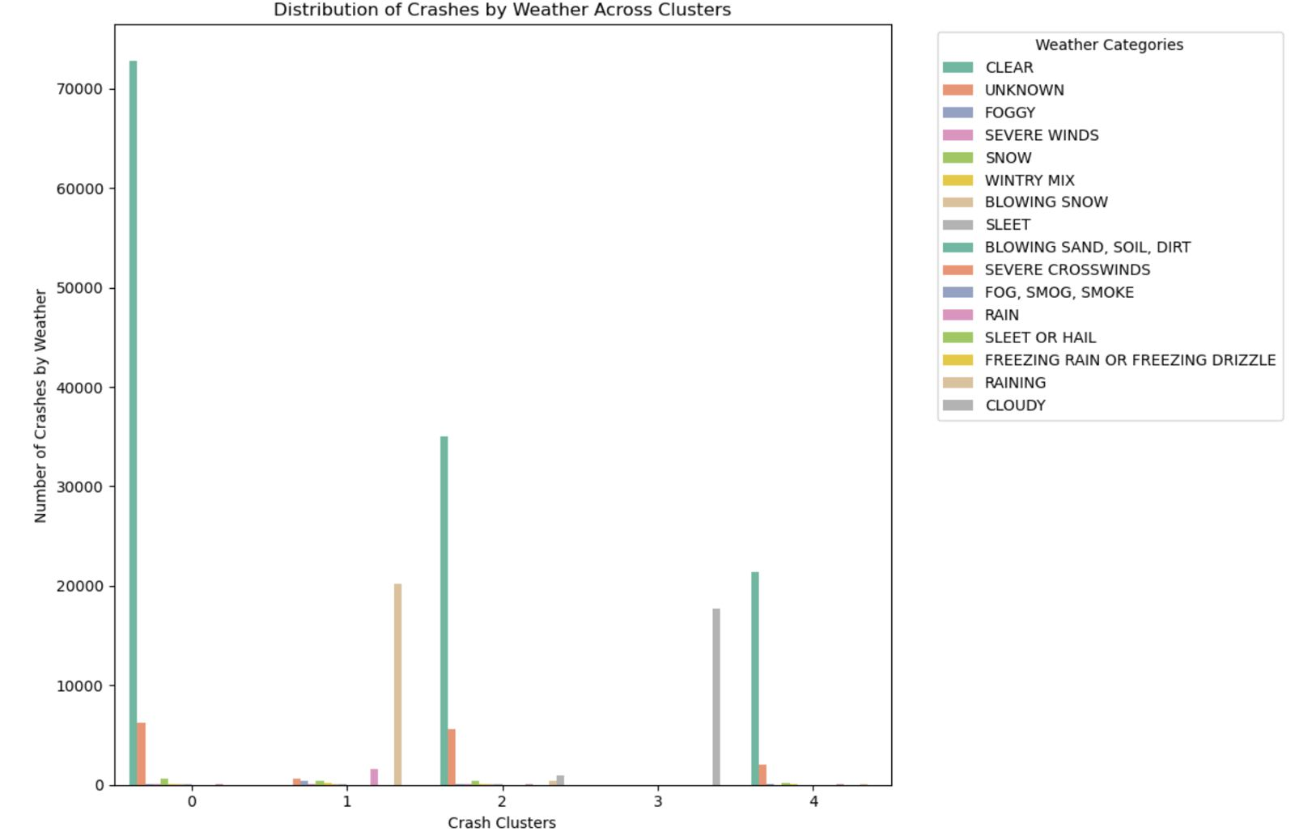

Slide 19
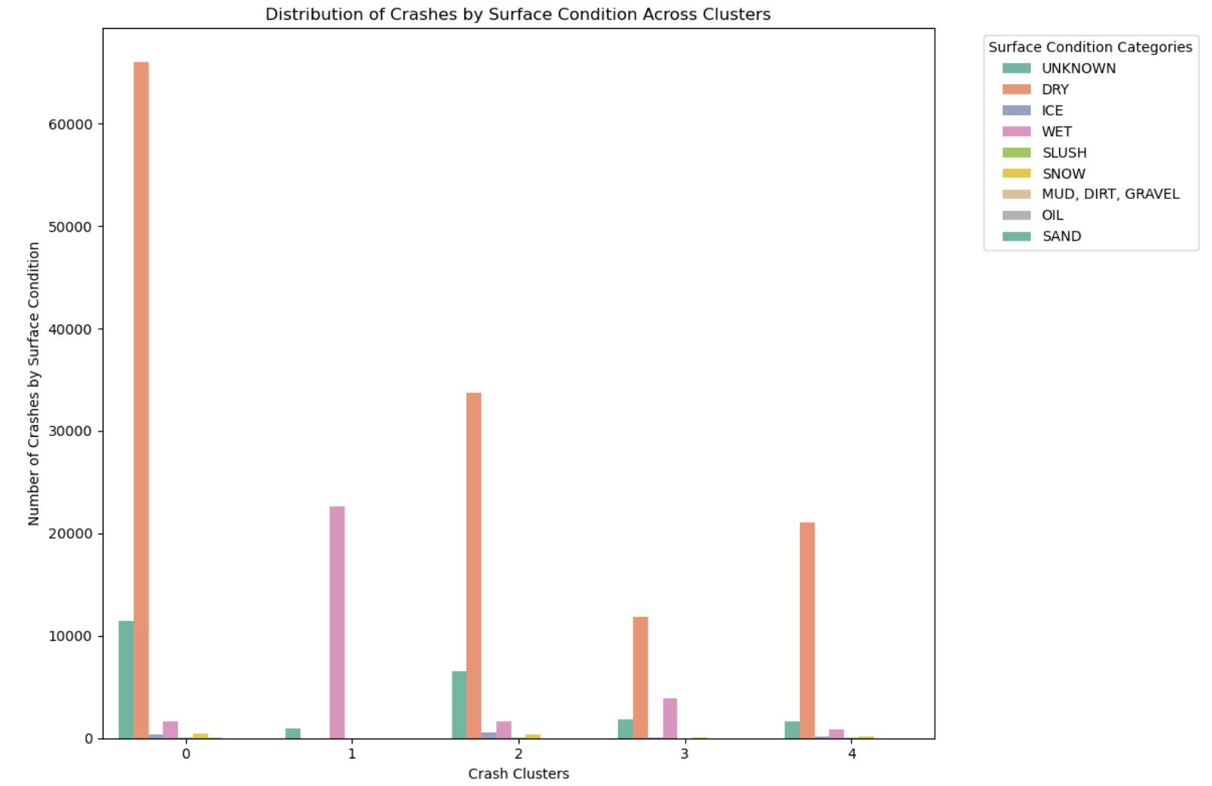

Slide 20
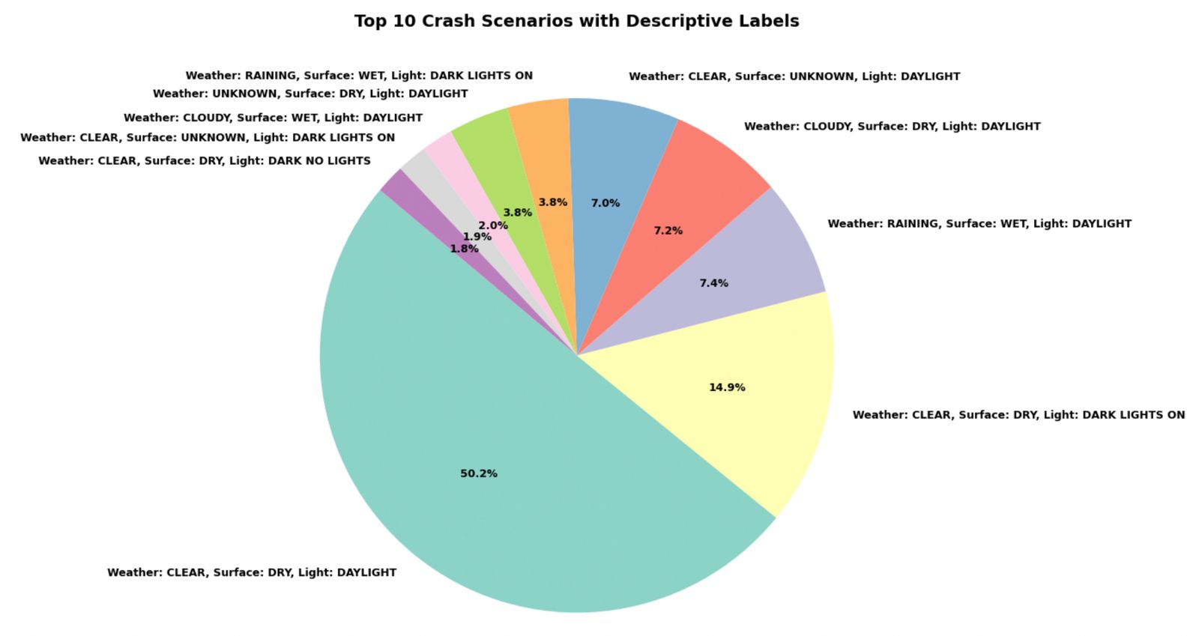

Slide 21
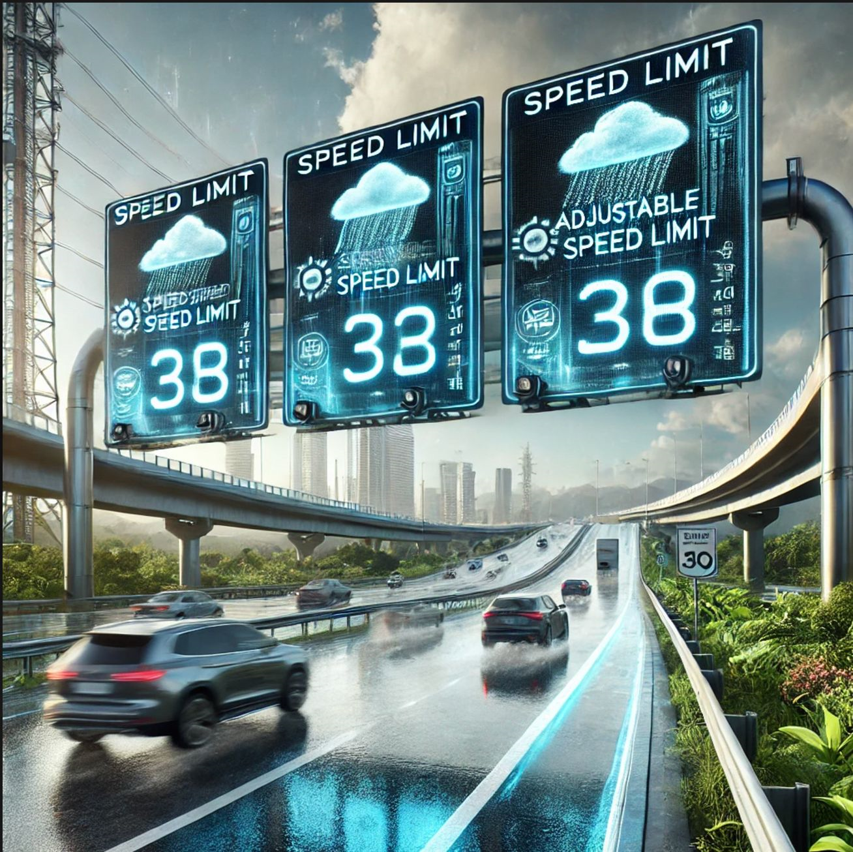

Managerial Insights
Use adjustable speed limits that change based on traffic or weather conditions. For example, speed limits could lower automatically if traffic is heavy or visibility is poor.

Slide 22
Finding #2: Higher Driver’s Fault rates found in Solo Crashes
Collision types involving individual vehicle control (e.g., single vehicle, rear-end movement) exhibit higher fault rates. Situations with shared driver responsibilities (e.g., sideswipes, turns) tend to have lower fault rates.

Slide 23
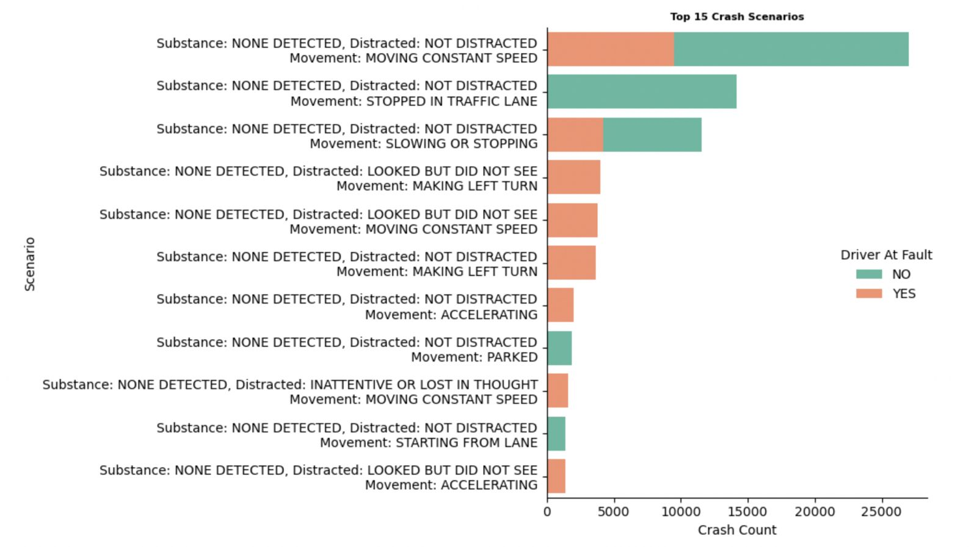

Slide 24
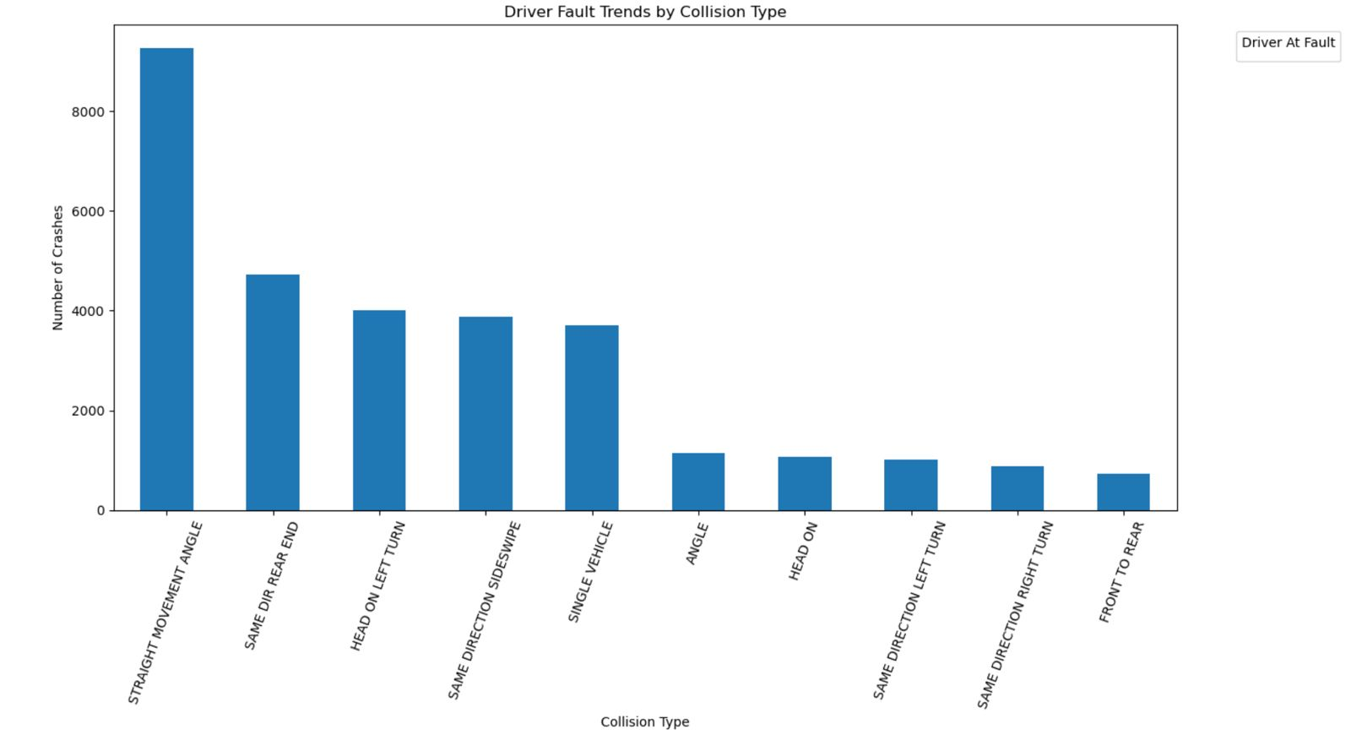

Slide 25
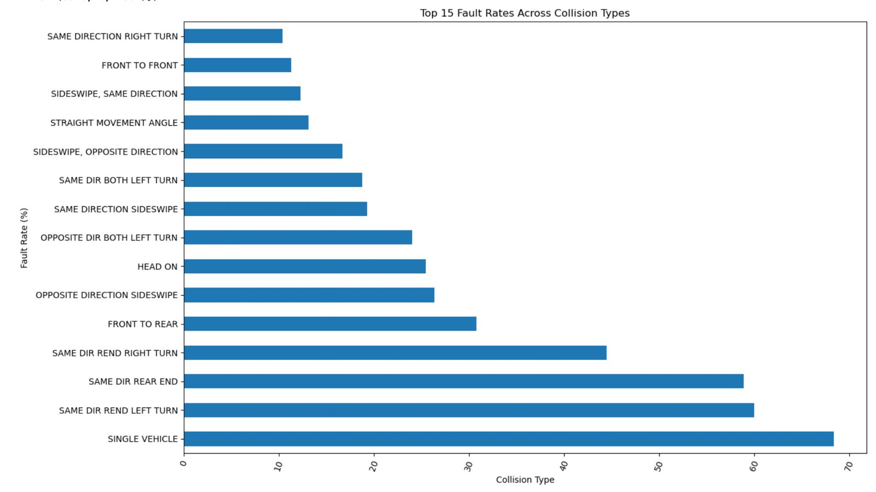

Slide 26
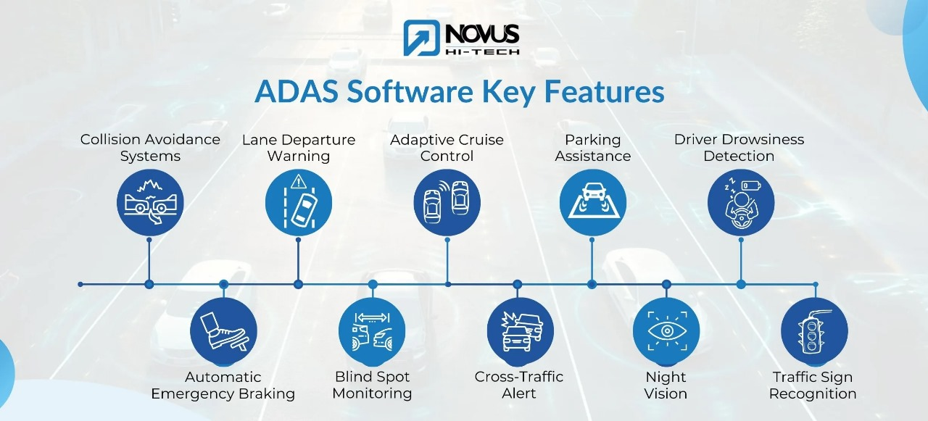
Managerial Insights
Encourage the adoption of technologies like lane-keeping assist, adaptive cruise control, and automatic emergency braking by offering tax incentives or subsidies for vehicles equipped with ADAS (Advanced Driver Assistance Systems) features.

Slide 27
Finding #3: Traffic control effectiveness
The observation that accidents and severe accidents occur at nearly equal rates regardless of traffic controls suggests that the presence of controls alone is insufficient to mitigate accident risks.

Slide 28
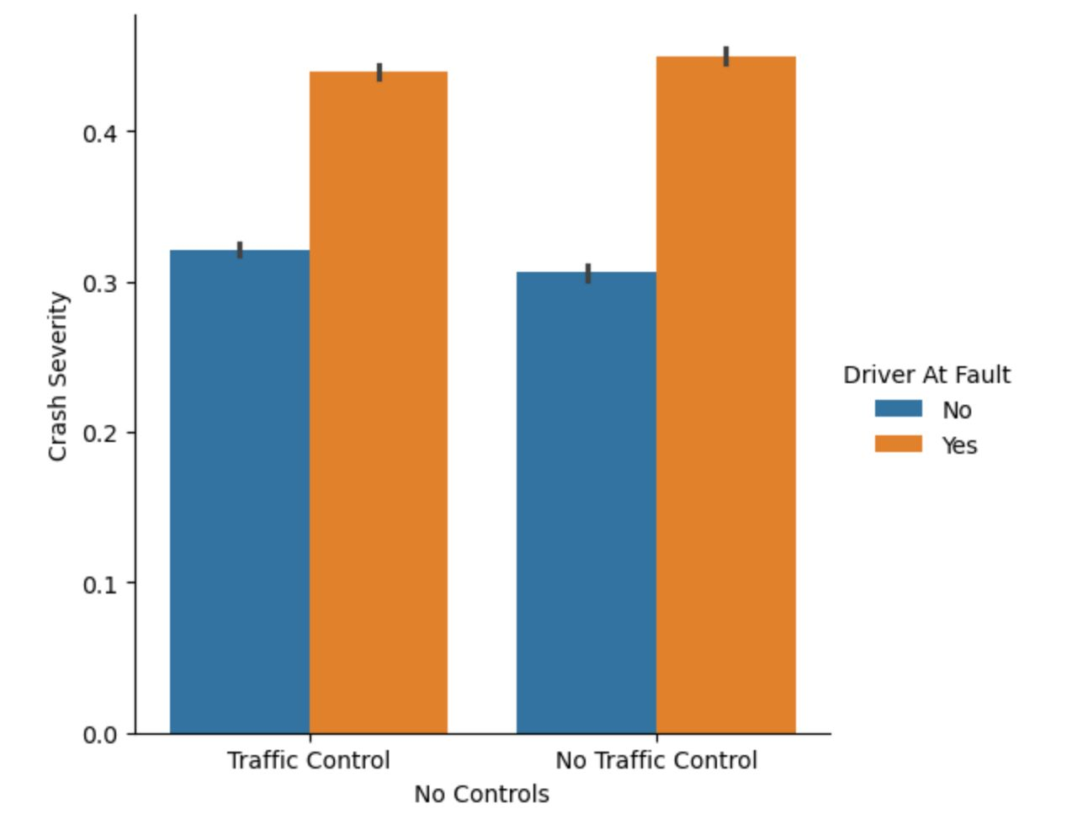

Slide 29
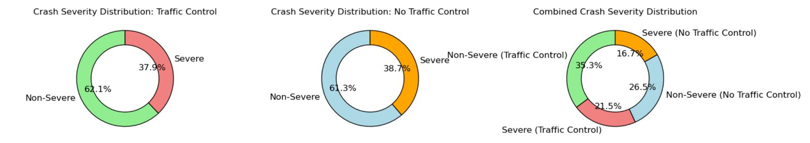

Slide 30
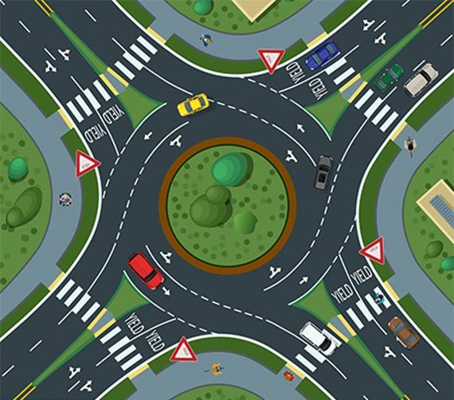
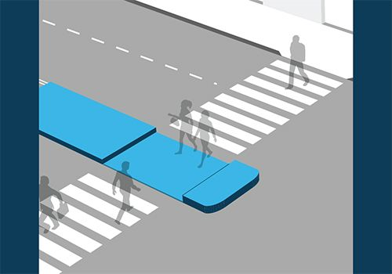
Managerial Insights
Expand the use of roundabouts to replace traditional intersections, promoting slower speeds and reducing crash severity. Increase the implementation of pedestrian refuge islands and dedicated bike lanes, building on existing efforts, to better protect walkers and cyclists and minimize conflicts with vehicles.

Slide 31

Q/A Session

Slide 32

Thank You

